Slide 1
Low Impedance Measurement Using Low Cost SDR VNA
Shrinithi Venkatesan
Adinath Phene
February 13, 2024

Slide 2
Agenda
Need for Low Impedance Measurement
Two Port Measurement Method
Lowest Impedance measured by the SDR VNA
RLC Characteristics Trends of Circuit Elements
Takeaways

Slide 3
Need for Low Impedance Measurement
Solder
Blobs
MLCC
Low Z
Measurement
SMT
Resistors
Vias
PDN
VRM
PDN components have target impedances in the mOhm range.
Not practical to measure Z < 0.1 Ohms using return loss 1-port VNA.
Real world limitations of Signal to Noise ratio & fixturing reproducibility.
2- Port method is a low-cost method to measure impedances even < 0.1 ohms.

Slide 4
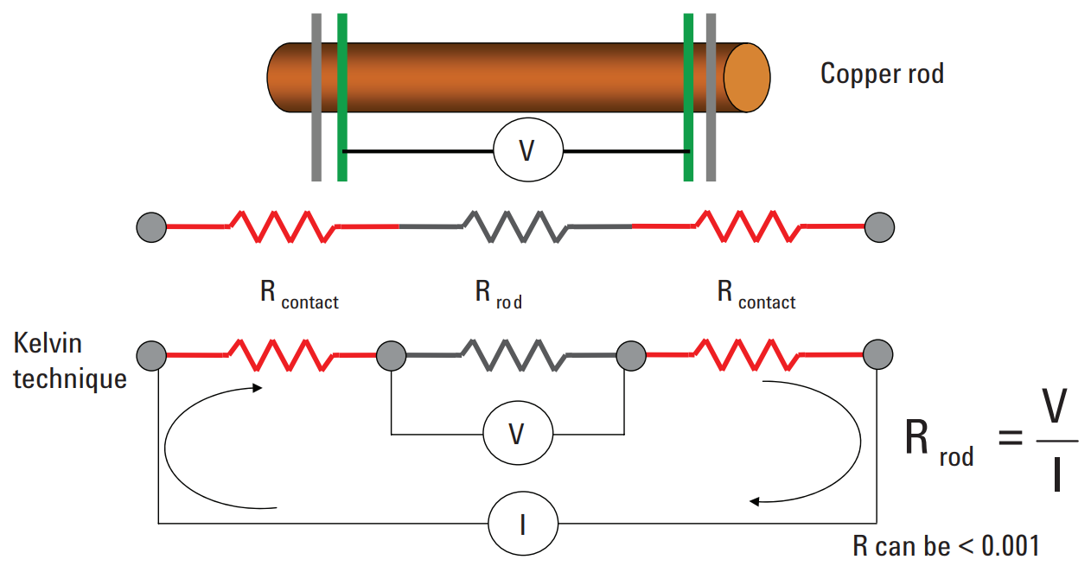
4 – Point Kelvin Method for Low Z Measurement
Rated Resistors (in Ohm)​ | Measured Resistance (Uncertainty ± 0.002) (in Ohm)
10 | 10.006
1 | 1.003
0.50 | 0.505
Measured resistors are within 1% tolerance of the rated values.
Next, we will correlate the measured & simulated impedance.
Measurement Set up for Calculating the Resistance.

Slide 5
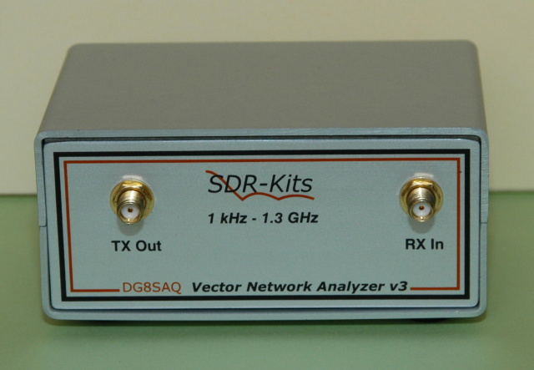
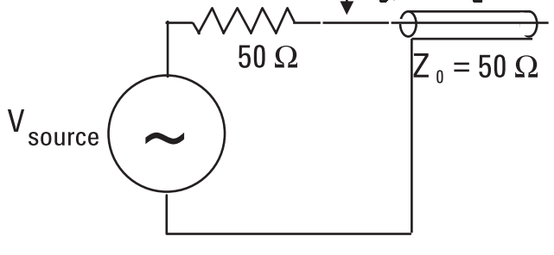
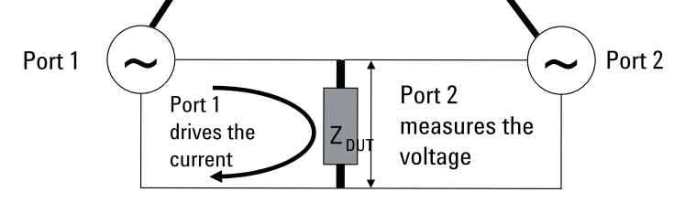
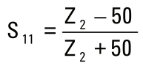
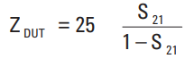
Low Impedance Measurement – 1 & 2 Port Method
1- Port Method (Z > 0.1 ohms)
2- Port Method (Z < 0.1 ohms)

Slide 6
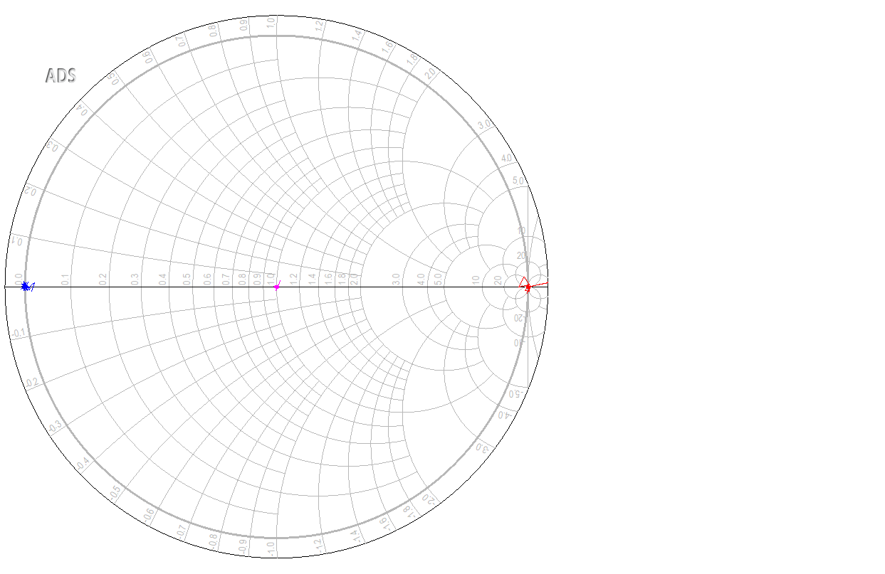
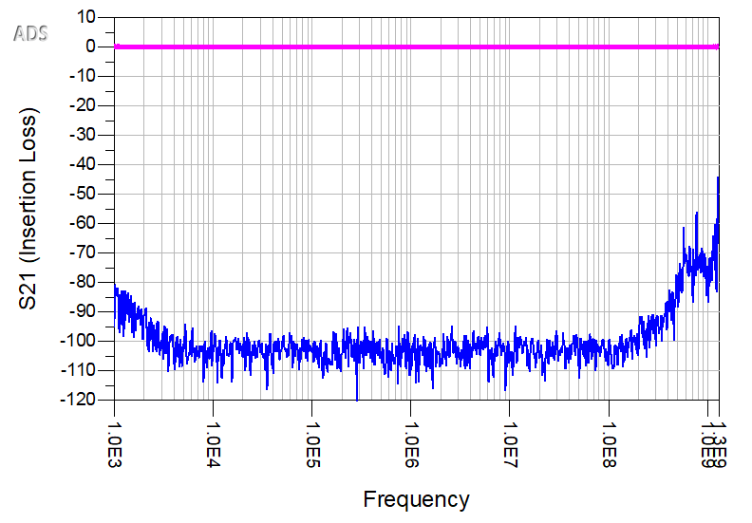
SDR VNA Calibration – Open, Short, Load & Through
Calibration
Open
Short
50 Ohm Load
Through – S21 (Insertion Loss)
Open – S21 (Noise Floor)
Open, short & 50-ohm load plotted on a Smith Chart.​
SDR VNA is calibrated.
Thru - Insertion Loss is 0dB (100% Transmission)
Noise Floor is the lowest impedance measured by the SDR VNA.

Slide 7
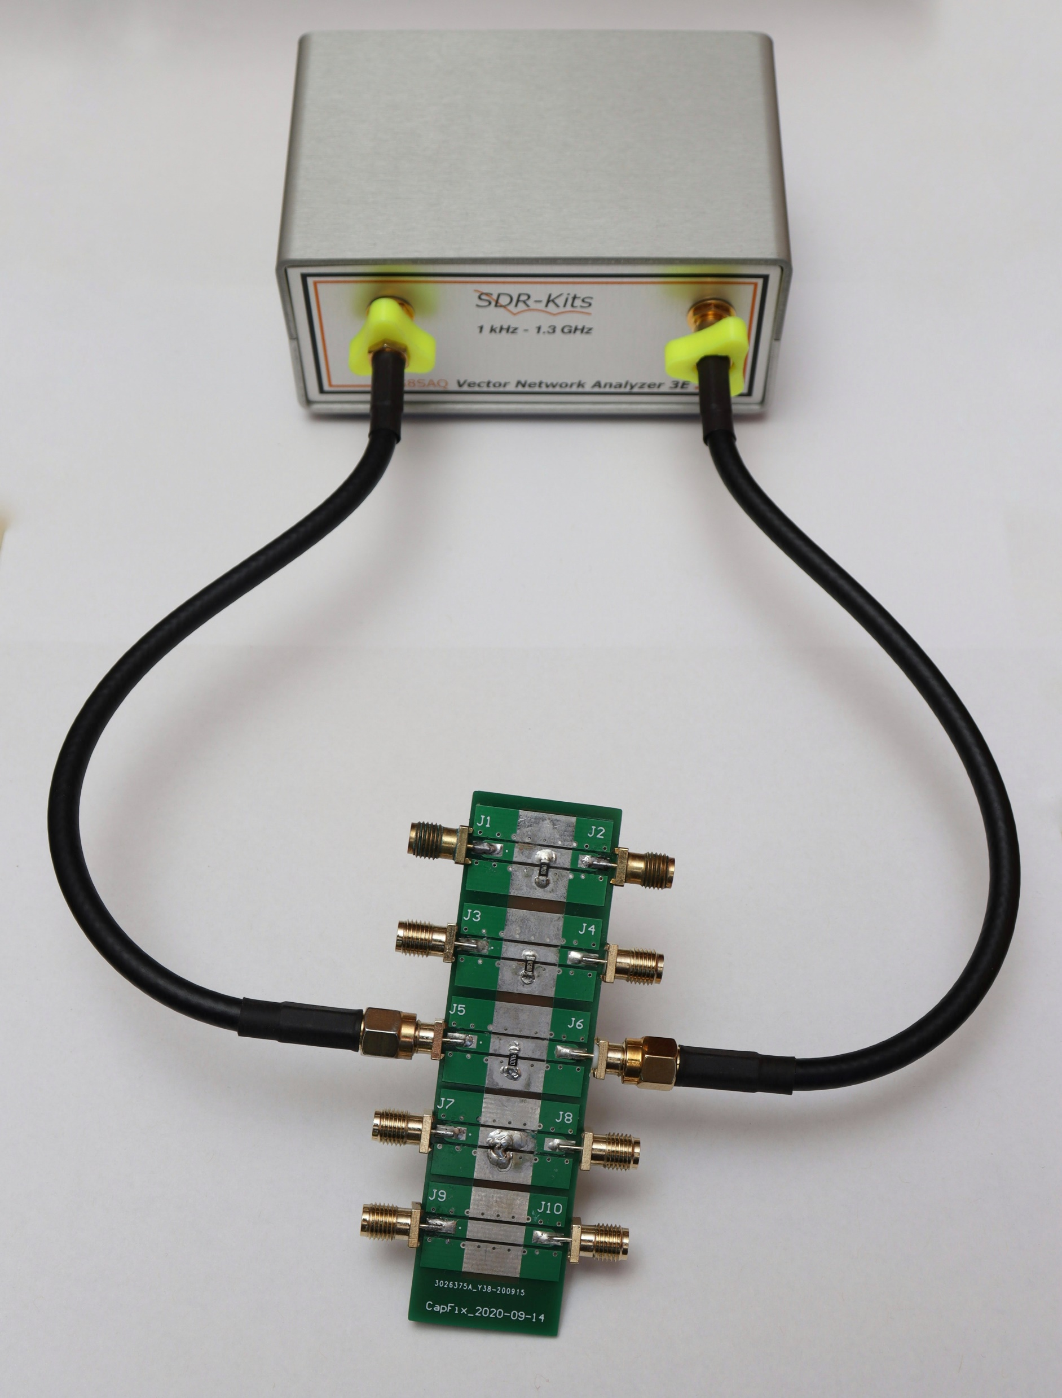
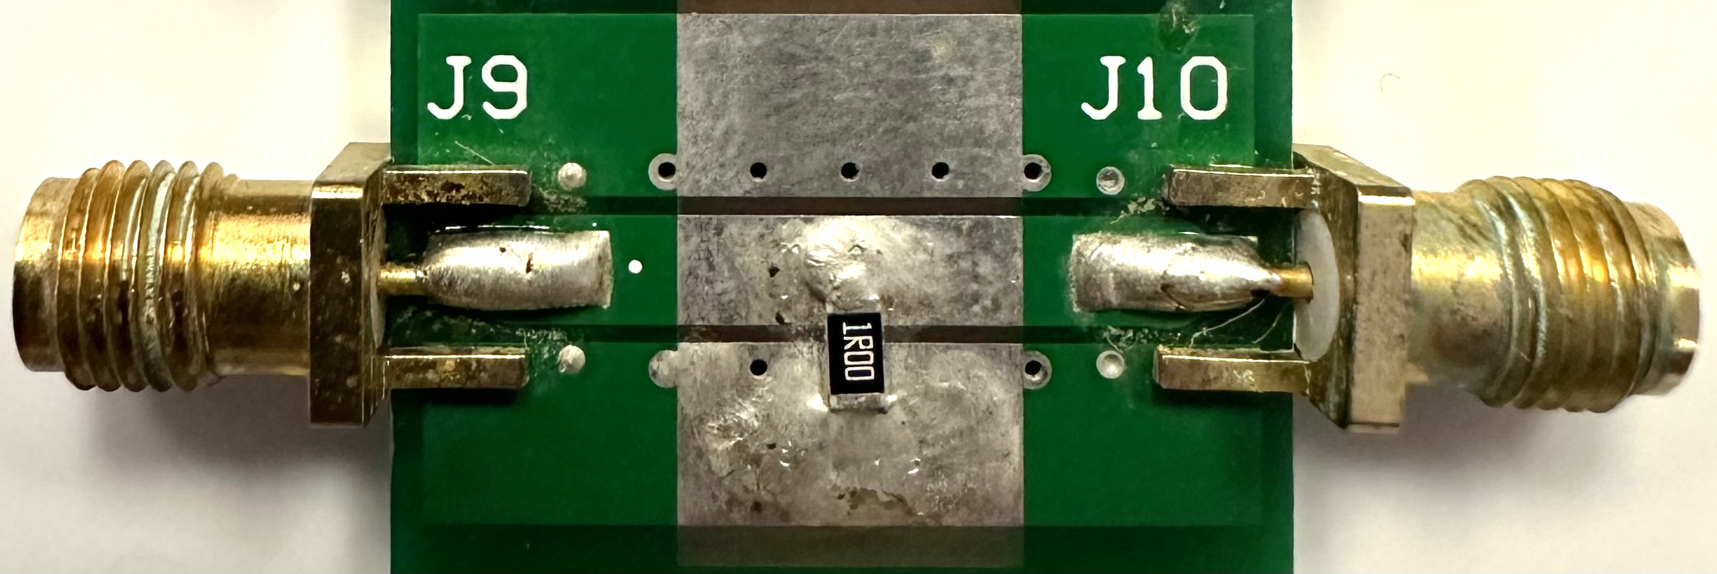
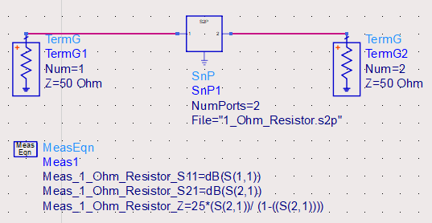
Correlation in Measured & Simulated Resistor Impedance
1 Ohm Resistor
Breakout Board
Plotting Measured Impedance in ADS

Slide 8
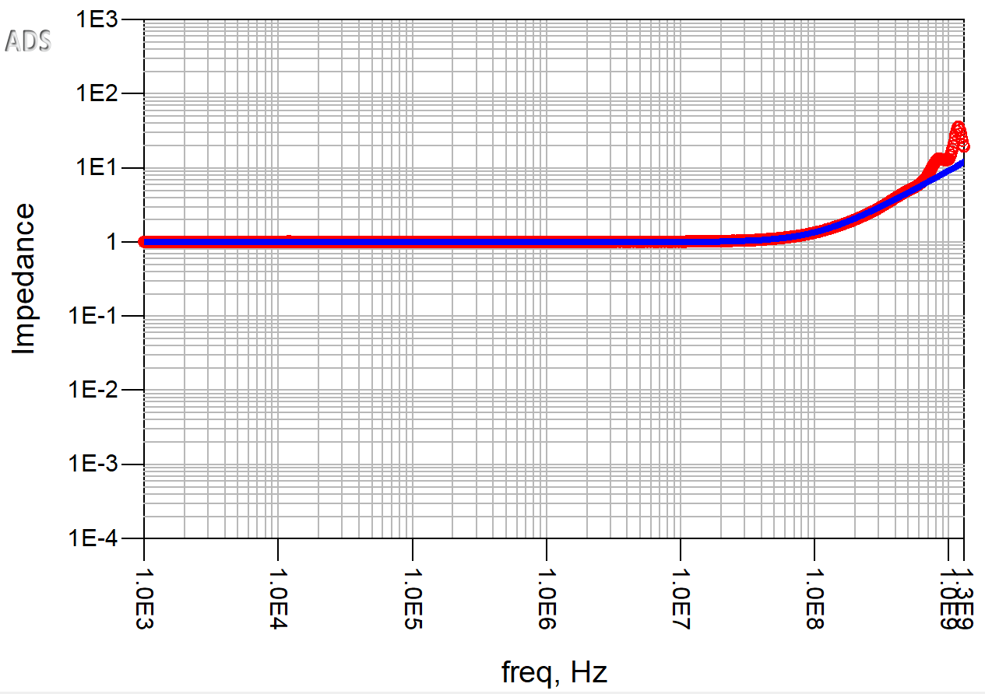
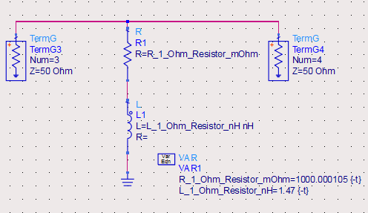
Measured & Simulated 1 Ohm Resistor Impedance
Measured Impedance - 1 Ohm Resistor
Simulated Impedance - 1 Ohm Resistor
Rated Resistor (in Ohm)​ | Modeled R (in Ohm) | Modeled ESL (in nH)
1.00 | 1.00 | 1.47
This simple RL model is an excellent model for the impedance behavior of this real resistor from low to high frequency.
ESL
Measured & Simulated Impedance correlate accurately.
R

Slide 9
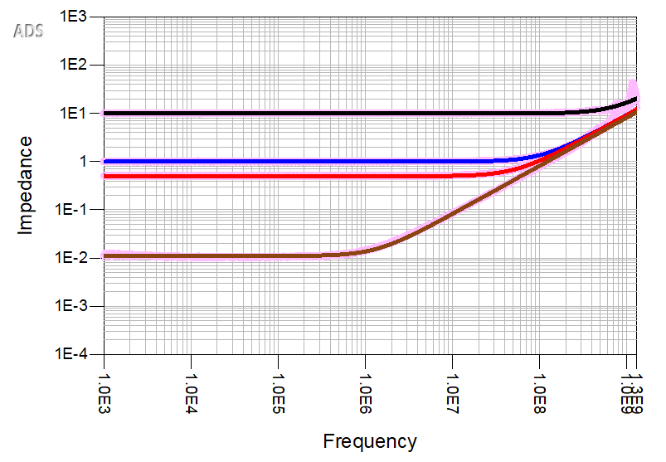
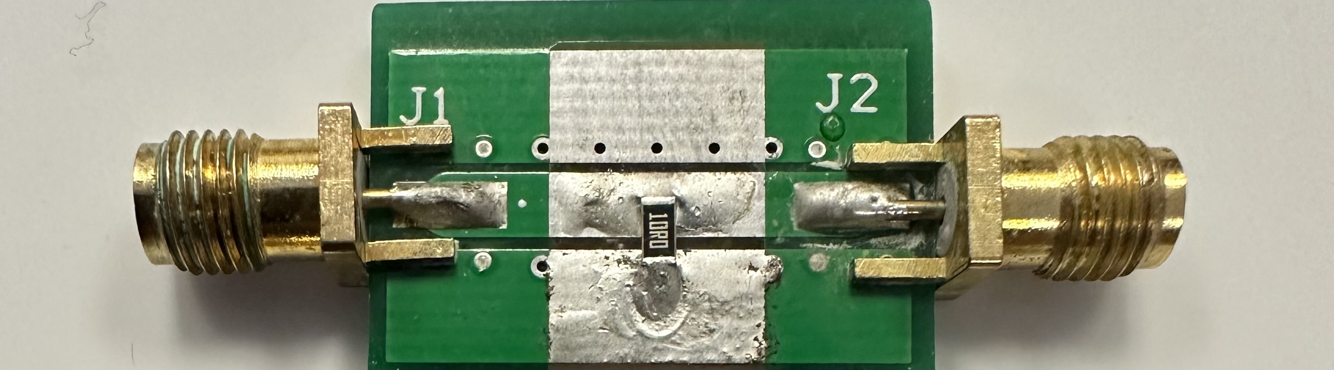
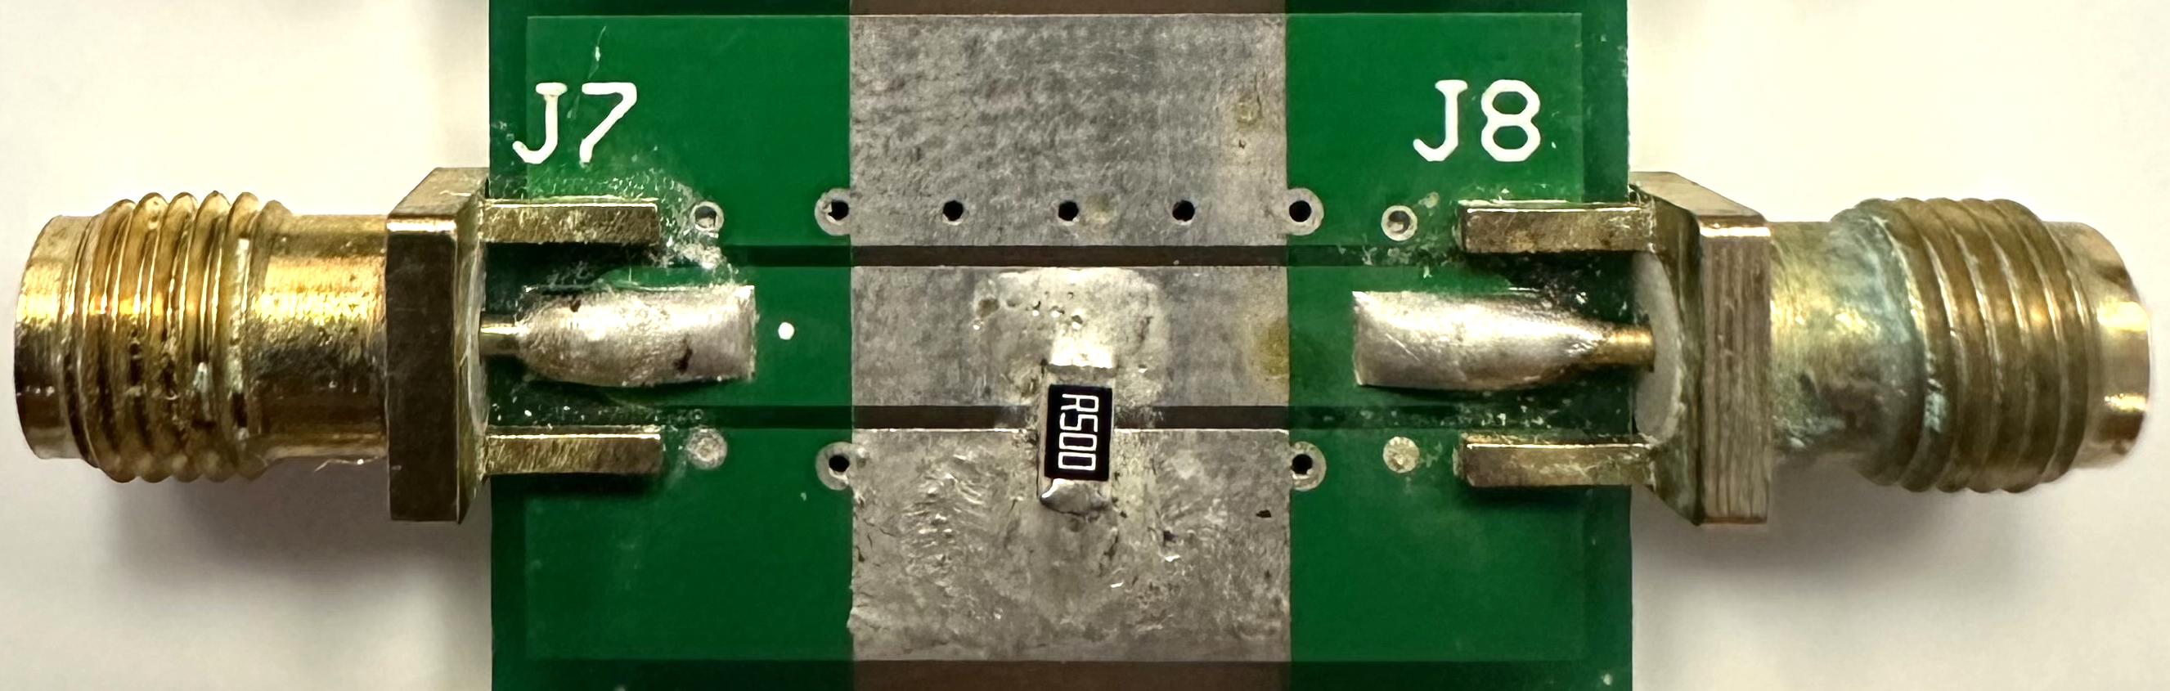
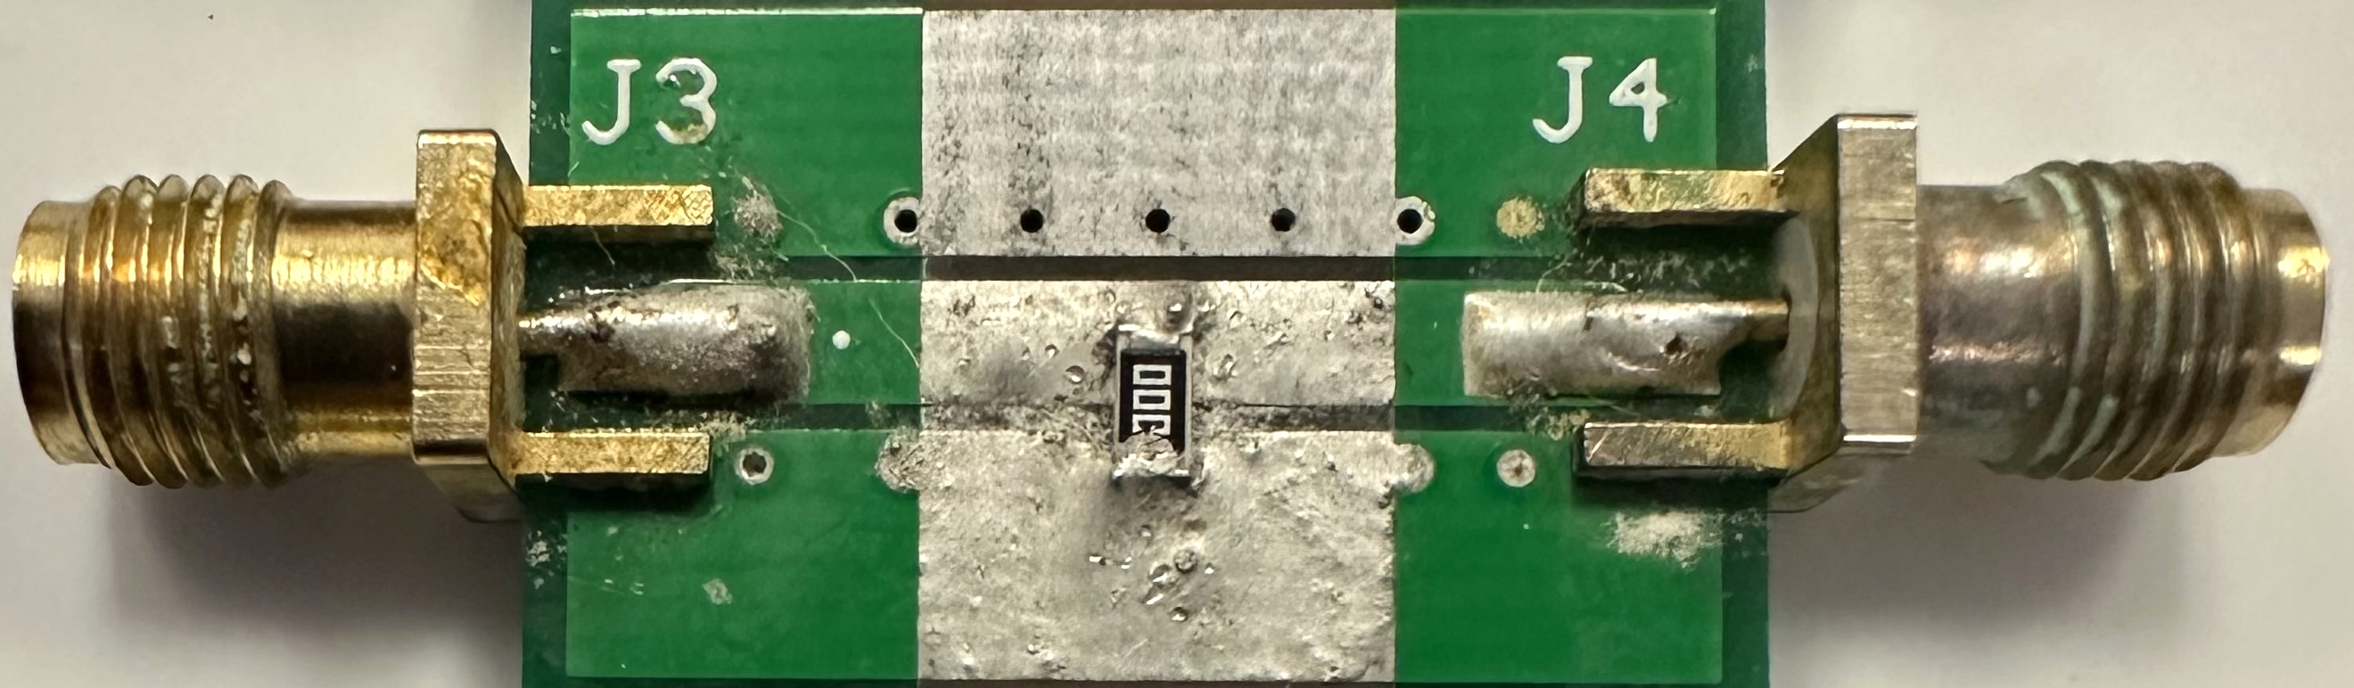
R & L Characteristics of SMT Resistors
10 Ohm
0.5 Ohm
10 Ohm
1 Ohm
Zero Ohm
1 Ohm
0.5 Ohm
Rated Resistors (in Ohm)​ | ModeledR (in Ohm) | ModeledESL (in nH)
1​0 | 10.00 | 1.47
1 | 1.00 | 1.47
0.5 | 0.50 | 1.47
Zero ​Ohm Jumper | 0.011 | 1.45
Zero Ohm Jumper
Simulated Impedance &
Measured Impedance All resistors
Similar ESL values due to identical footprint.
Zero Ohm Jumper has the lowest resistance.

Slide 10
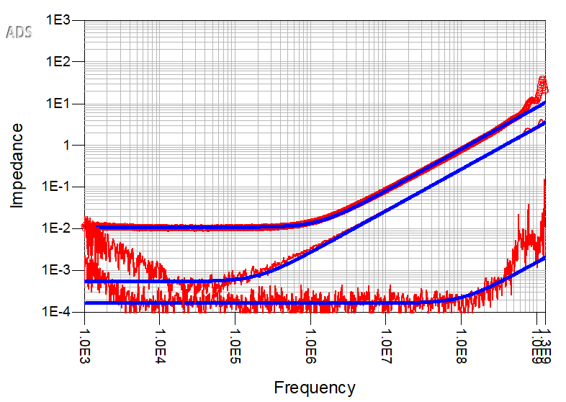
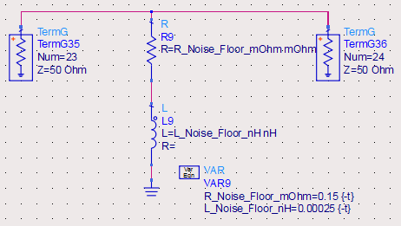
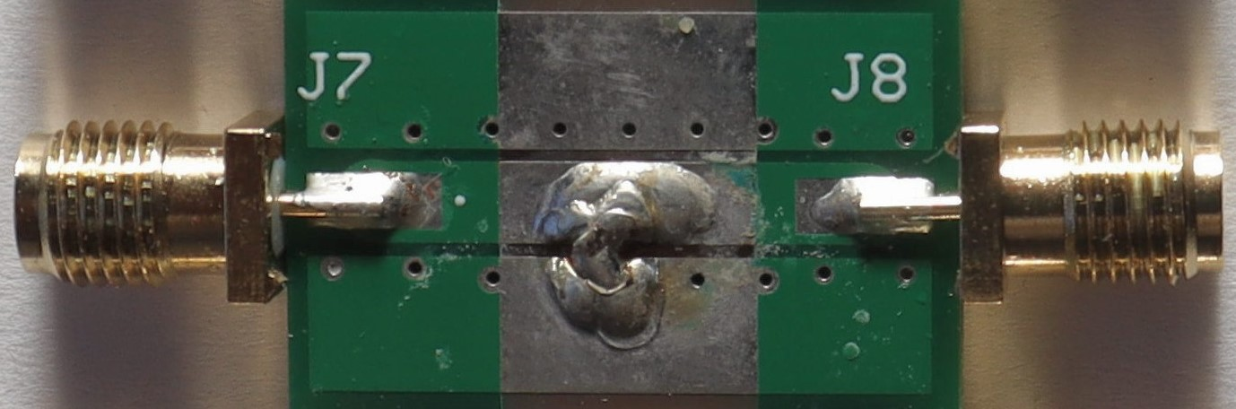
Lowest Impedance Measured by SDR VNA
Measured Impedance
&
Simulated Impedance
Solder Blob
(Made wide & thick to have
Low R & L)
Zero Ohm Jumper
Resistor Structures | Modeled R (in mOhm) | Modeled ESL (in nH)
Zero Ohm Jumper | 11 | 1.45
Solder Blob | 0.55 | 0.45
Noise Floor | 0.15 | 0.00025
Noise Floor
Noise Floor Resistance: 0.15 mohm Noise Floor Inductance: 0.25 pH
Lowest Impedance measured by the SDR VNA is the Noise Floor.

Slide 11
Takeaways
The 2-port method can eliminate the artifacts associated with contact impedance of the probes or fixturing to the DUT.
2- Port Method is a low-cost and reliable method for Low Z Measurement.
First order RL models can be used to hack the impedances measured with the 2-port method to correlate measured & simulated data.
SDR VNA can measure resistances & inductances in the mOhm and pH range respectively.
ESL of components depends on their footprint.

Slide 12
Questions?

Slide 13
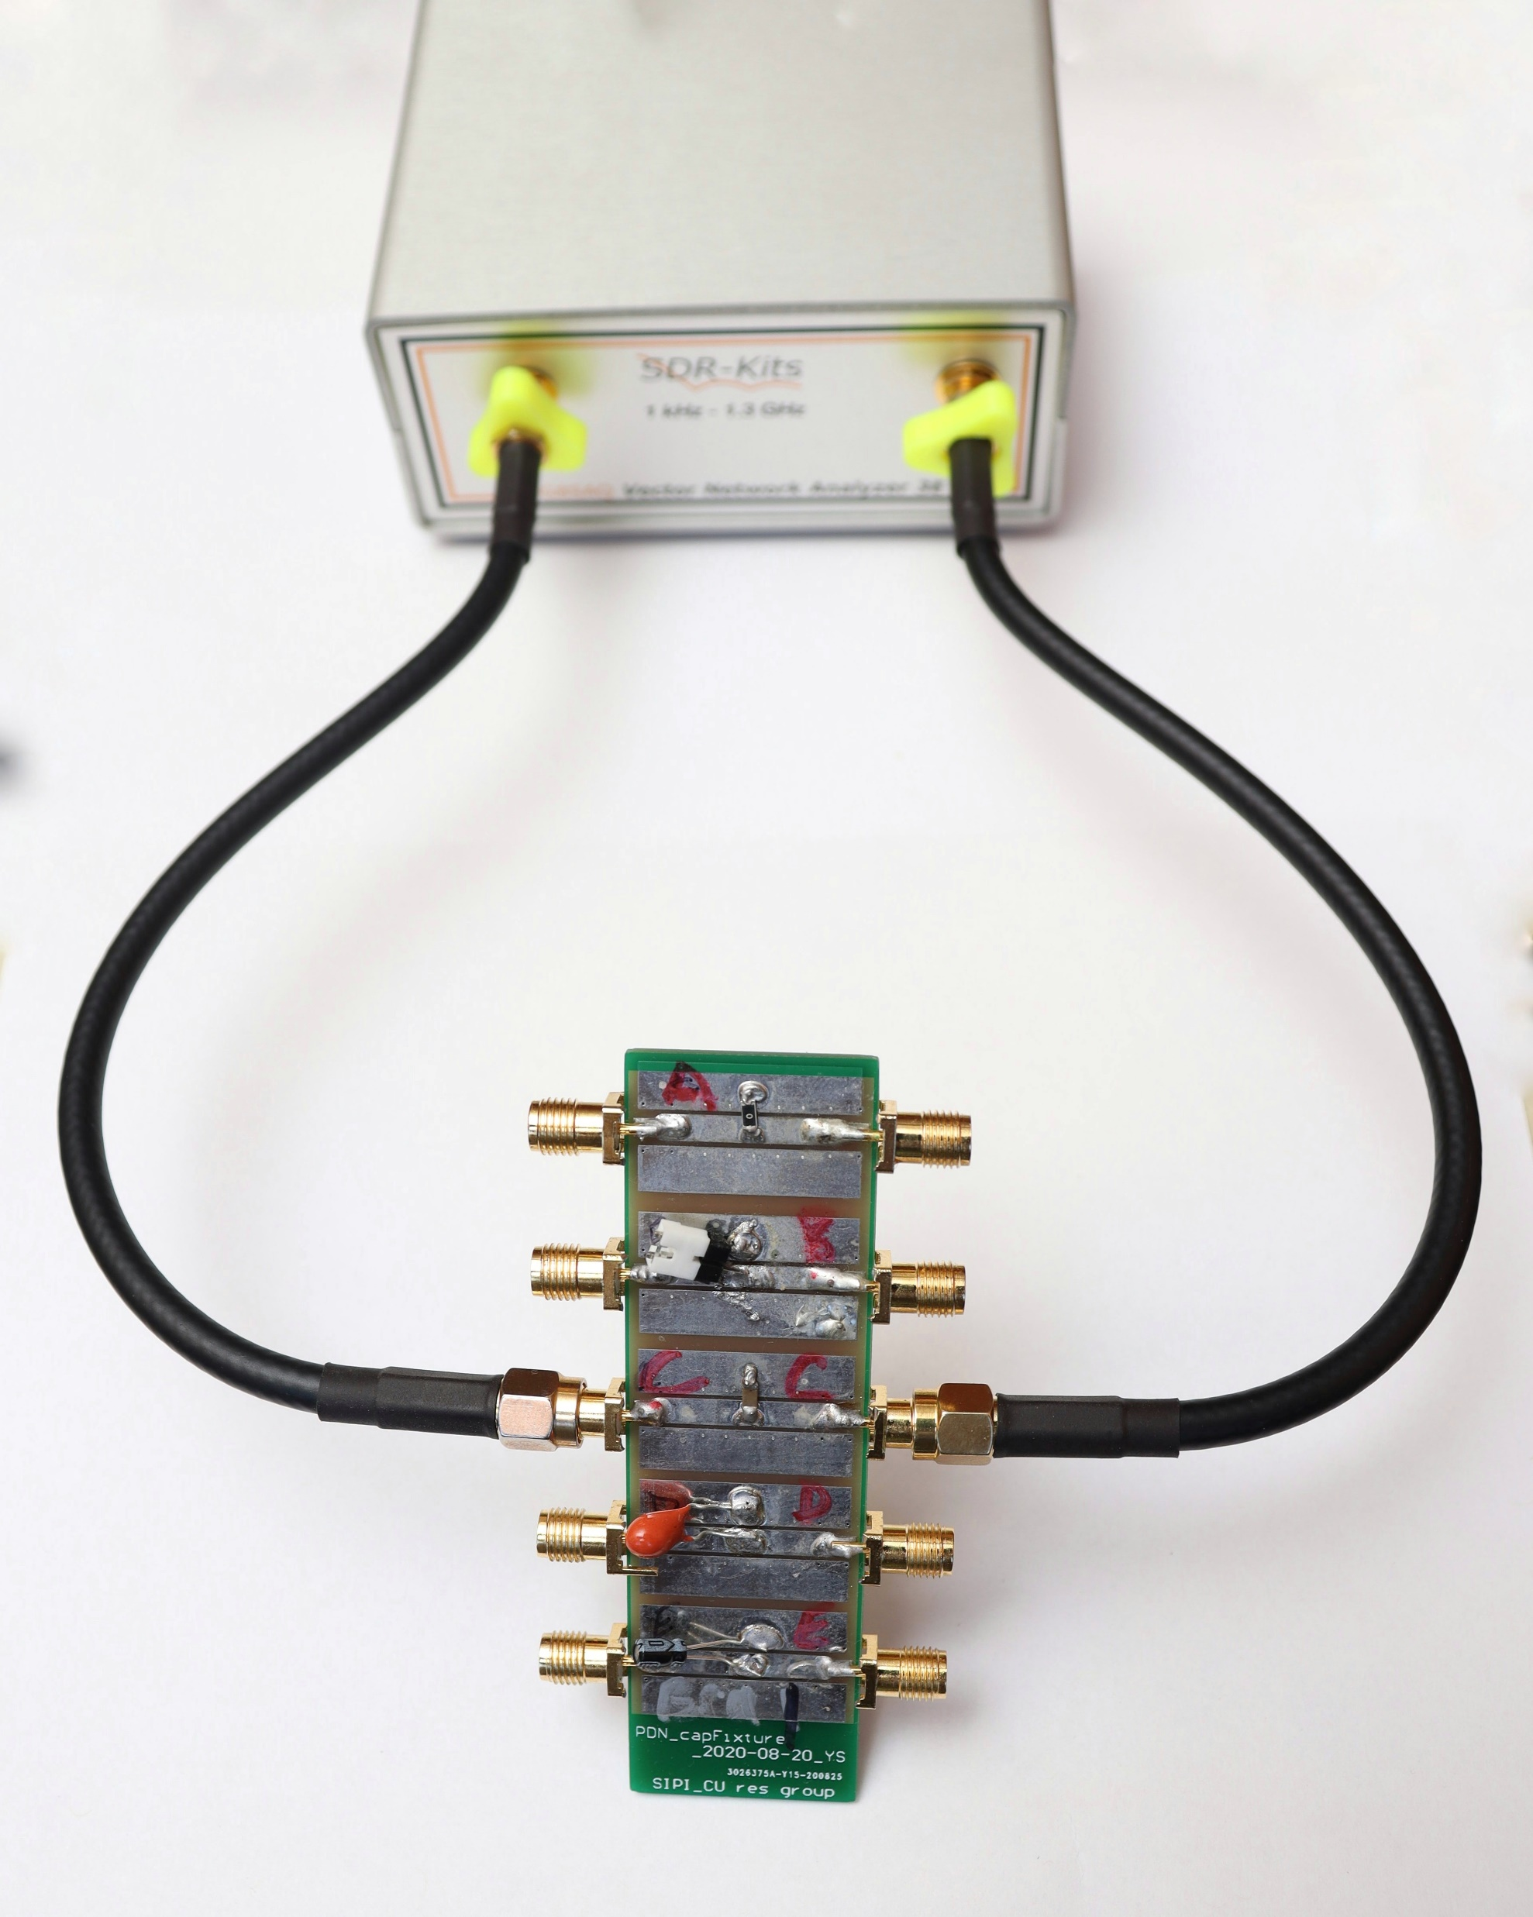
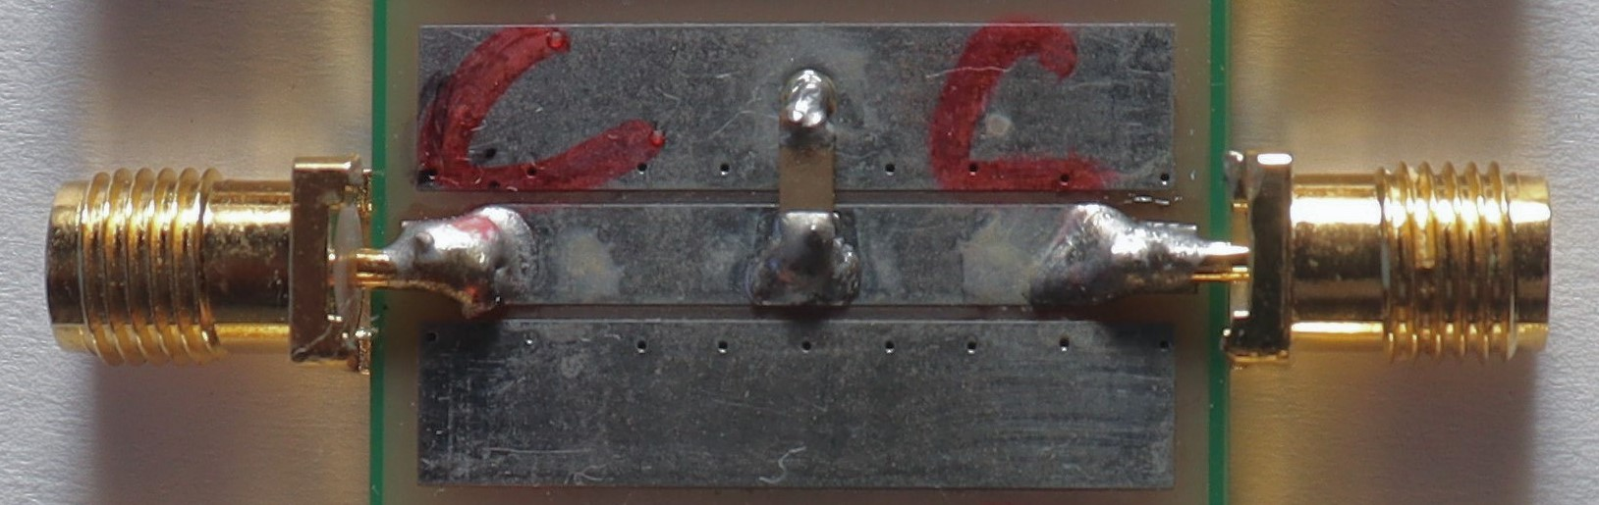
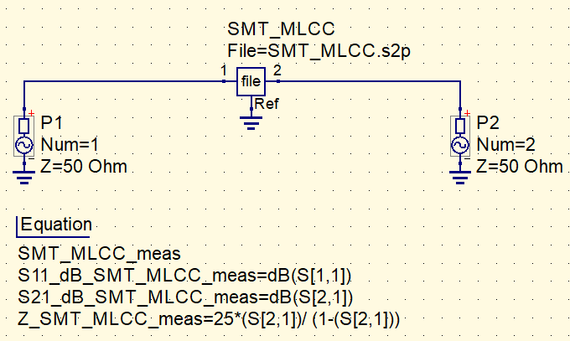
RLC Equivalent Z for an SMT MLCC
15 uF SMT MLCC
Breakout Board
Plotting Measured Impedance in Qucs

Slide 14
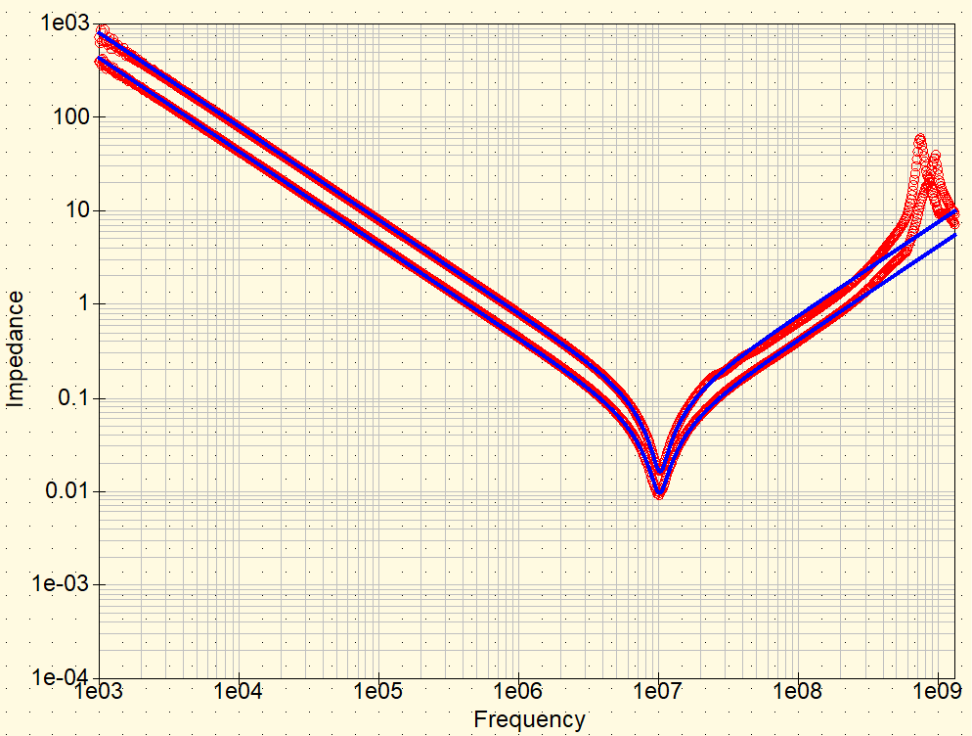
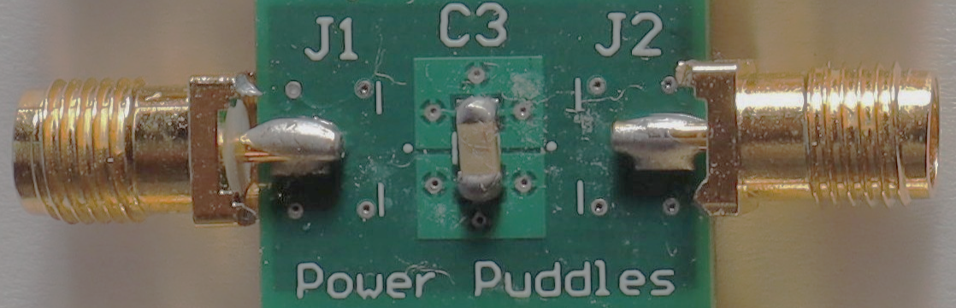
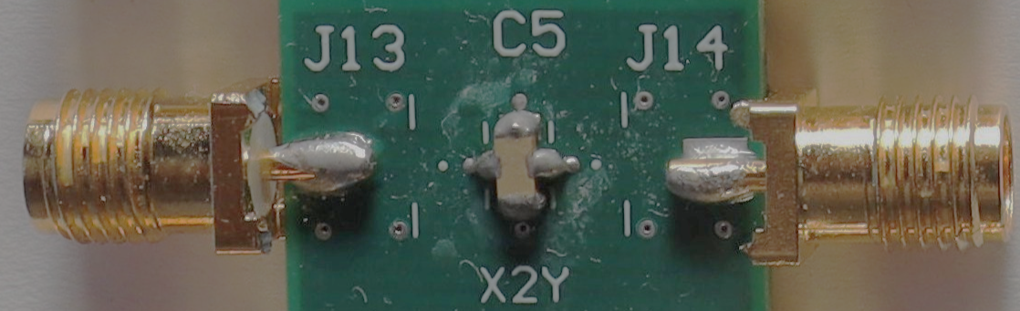
Reduced Inductance of MLCC – X2Y
Measured Impedance
Board Structure | ESR (in mOhm) | ESL (in nH) | C (in uF)
Multiple Vias | 16.3 | 1.225 | 0.20
X2Y | 9.63 | 0.675 | 0.368
Simulated Impedance
Multiple Vias
X2Y Capacitor
X2Y capacitors have a much lower inductance than Multiple Vias structure.
There is a reduction of a factor of 2 in ESL.
This translates into a reduction in the impedance at high frequency by a factor of 2 and could enable a parts count reduction by a factor of 2 as well.
Multiple Vias
X2Y Capacitor

Slide 15
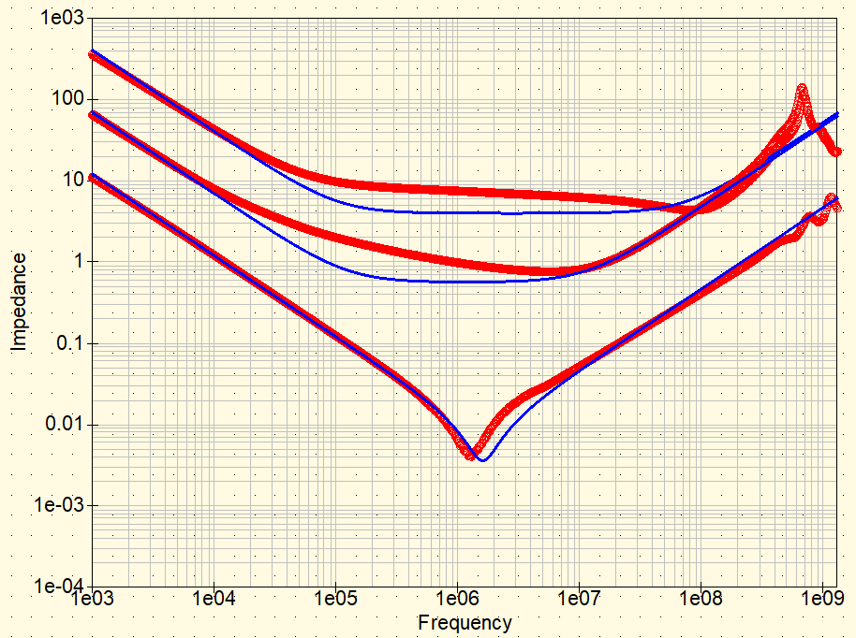
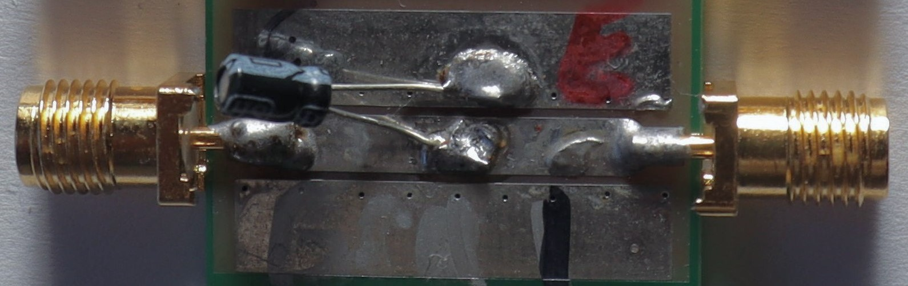
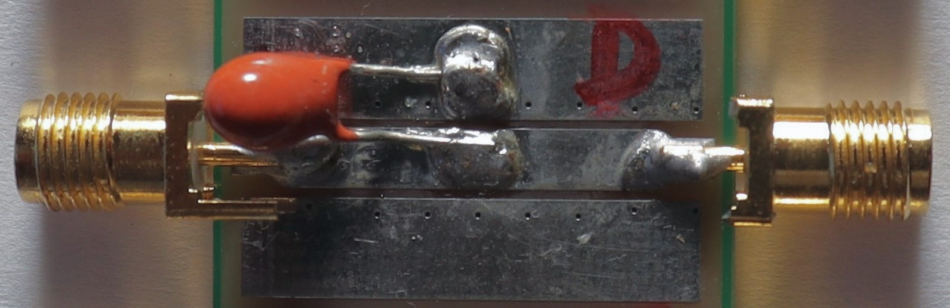
RLC Equivalent Z for Electrolytic & Tantalum Capacitors
Measured Impedance
Rated Capacitance (in uF)​ | ESR (in Ohm) | ESL (in nH) | C (in uF)
15 (SMT MLCC) | 0.00366 | 0.75 | 13.2
0.47 (Electrolytic) | 4 | 8.4 | 0.39
2.2 (Tantalum) | 0.57 | 7.70 | 2.28
Simulated Impedance
Electrolytic Cap
Tantalum Cap
SMT MLCC
This is the best match we can get with a first order simulated RLC model.
ESR for the SMT MLCC is much lower than the Electrolytic & Tantalum Capacitors.
Electrolytic & Tantalum Capacitors have a much higher ESL due to the leads.
Electrolytic Capacitor
Tantalum Capacitor

Slide 16
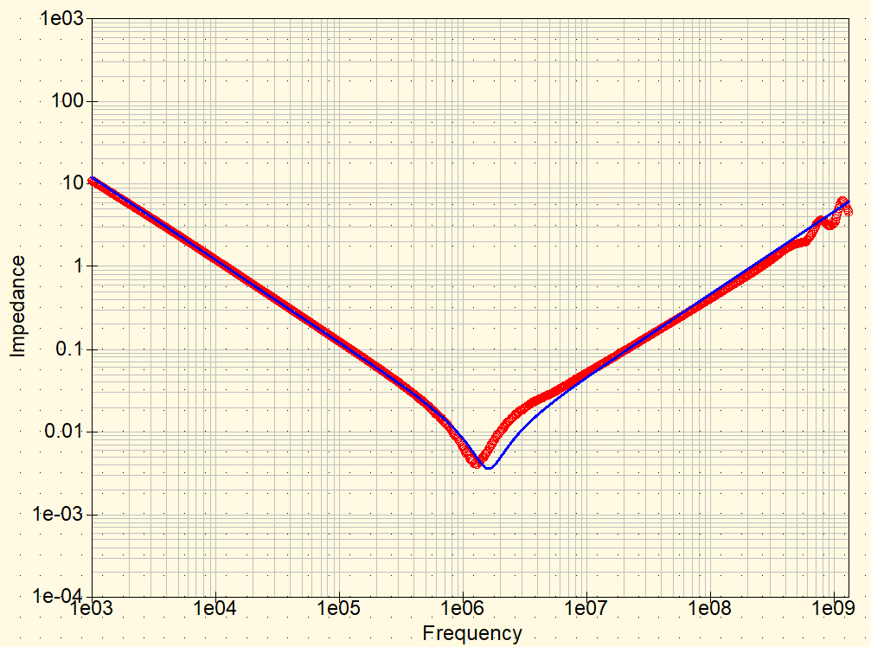
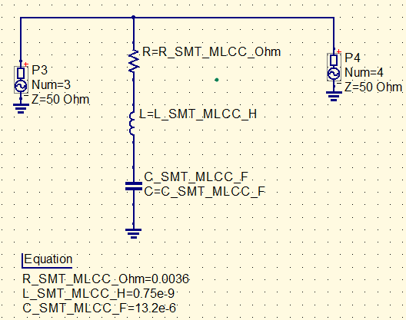
RLC Equivalent Z for an SMT MLCC
Measured Impedance – SMT MLCC
Simulated Impedance – SMT MLCC
C
ESL
Rated Capacitance (in uF) | ESR (in mOhm) | ESL (in nH) | C (in uF)
1​5 | 3.6 | 0.75 | 13.2
ESR
ESL for SMT MLCC is extremely low & this is the best match we can get using a first order model.
This simple RLC model is good enough to match the impedance behavior of the real SMT MLCC component.

Slide 17
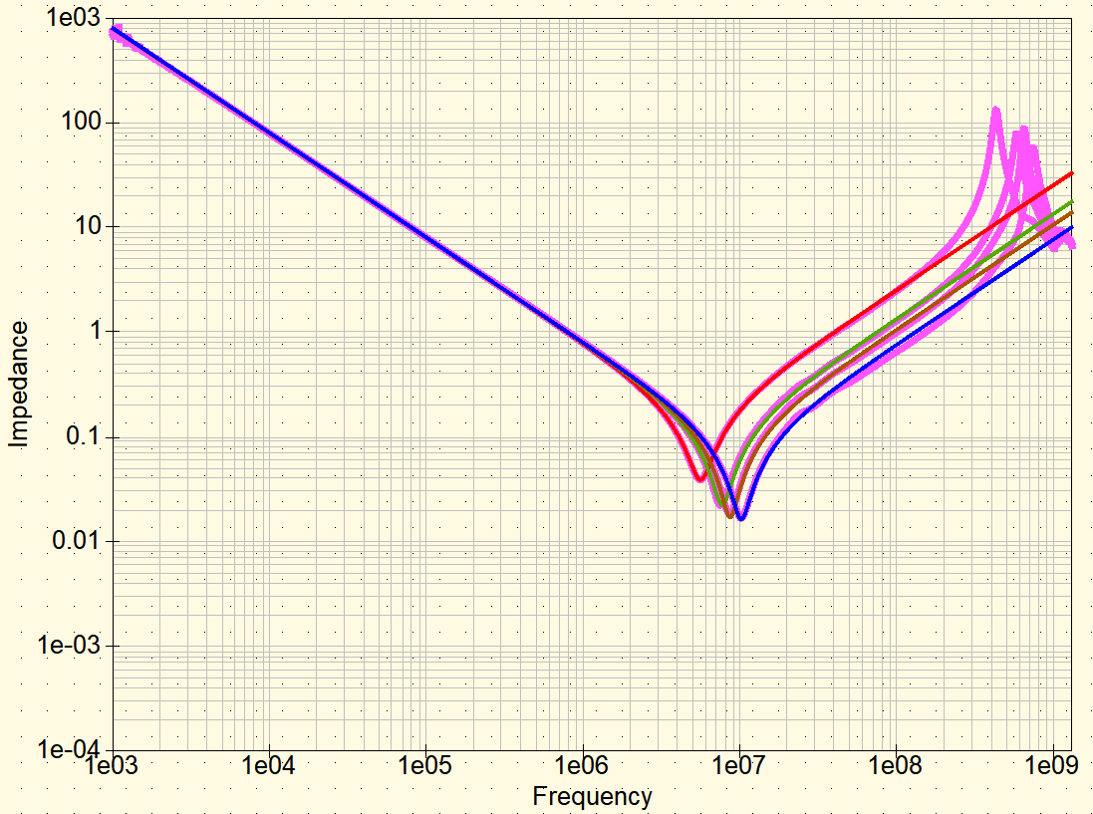
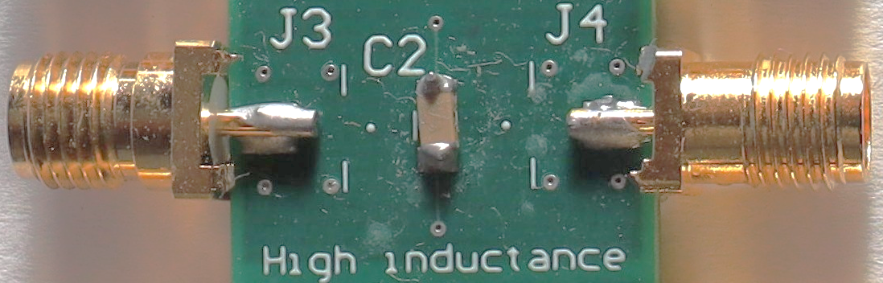
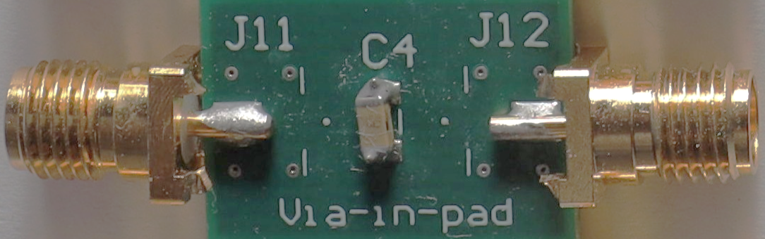
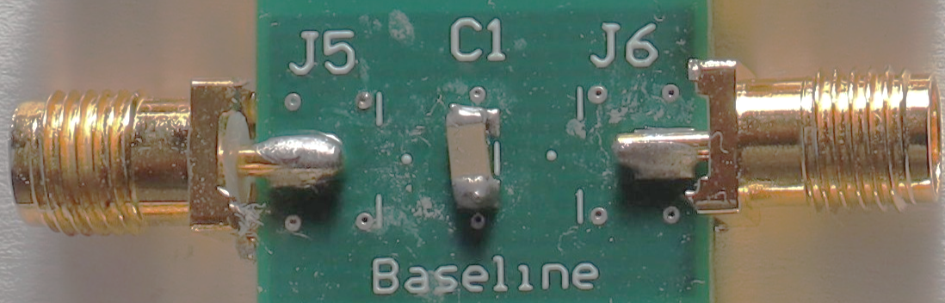
ESL of 0.22 uF MLCC with different Via positions
Simulated Impedance
Vias 20 mils from Pad
Vias 5 mils from Pad
Vias in the Pad
Multiple Vias
Via Position | ESR (in mOhm) | ESL (in nH) | C (in uF)
20 mils from Pad | 38.8 | 4.05 | 0.20
5 mils from Pad | 22.3 | 2.15 | 0.20
In the Pad | 17 | 1.7 | 0.20
Multiple Vias | 16.3 | 1.225 | 0.20
Measured Impedance
All Structures
Vias
20 mils from Pad
Vias
in the Pad
ESL is not an intrinsic measure of the capacitor itself as it is strongly dependent on how the capacitor is mounted to the planes.
Vias
5 mils from Pad
Multiple
Vias

